Slide 1
Planar Graph and Coloring
Lecture 12
Discrete Mathematical Structures

Slide 2
In the Last Class…
Part I: Network and Flow
  Transport networks and Maximum flow
  Labeling algorithm
  Matching in a bipartite graph
  Existence Condition of Perfect Matching
Part II: Matching
  Matching in a bipartite graph
  Existence Condition of Perfect Matching

Slide 3
Planar Graph and Coloring
Part I: Coloring
  Scheduling Problem
  Vertex Coloring of Graph
Part II: Planar Graph
  Planar Graph and Euler Theorem
  Four-color Problem
  Five-color Theorem

Slide 4
Scheduling Problem
Problem 1：Scheduling final examination, without any conflict on the side of students.
Problem 2：Storing chemicals, without any risks on the possible mixture

Slide 5
Chromatic Number of Graph
Definitions
  Coloring each vertex in a graph without rings, if no adjacent vertices has the same color, the coloring is called a proper coloring.
  The smallest number of colors needed to produce a proper coloring of a graph G is called the chromatic number of the graph, denoted by χ(G).

Slide 6
Solution for the Scheduling Problem
Mathematical model using graph
  Each vertex for a course, two vertices adjacent if and only if the two courses are taken by the same students. (So, they must be in different time slots)
Solution
  A allowed coloring of the graph is a solution
  The chromatic number is the least time slots needed

Slide 7
“Commonsense” about χ(G)
χ(G)≤|V_{G}|, and only when G=K_{n} the equality holds
If H is a subgraph of G，If χ(H)=k, then χ(G)≥k。
If d(v)=k, then all the vertices adjacent to v can be properly colored in at most k colors.
The chromatic number of G is the chromatic number of the largest component of G.

Slide 8
Chromatic Number: Examples
χ(G)=1 iff. there is no edges in the graph
χ(K_{n})=n
If G is a cycle:
  If |V_{G}|=2k, χ(G)=2
  If |V_{G}|=2k+1，χ(G)=3
If G is a wheel
  If |V_{G}|=2k, χ(G)=4
  If |V_{G}|=2k+1，χ(G)=3

Slide 9
Bipartite Graph
Graph G is bipartite if and only if there is no odd cycle in G.
  ⇒ The vertices in any cycle must be in V₁ and V₂ alternatively. So, the cycle must be even.
  ⇐ (Only connected graph considered) for a specific u∈V_{G}, create a partition of V_{G} as following: ∀v∈V_{G}, if d(u,v) is even, put v in V₁, otherwise v in V₂. Let x,y∈V_{G}, satisfying x,y in the same block, and xy∈E_{G,} then the length of ux+uy+xy is odd. Contradiction.

Slide 10
Chromatic Number of Bipartite Graph
If there is at least one edge in G, then χ(G)=2 if and only if G is a bipartite graph.
  ⇒ If χ(G)=2，then there is no odd cycle in G.
  ⇐ If G is a bipartite graph, we can use one color for all vertices in one block.

Slide 11
Critical Graph
Definition: If the chromatic number of graph G is k, but, ∀v∈V_{G}, χ(G-v)<k, then G is a k-critical graph
  G is a k-critical graph means that χ(G)=k, but, any proper subgraph of G has a chromatic number less than k
Every k-chromatic graph contains a k-critical subgraph.
If G is k-critical, then G must be connected.
  Note: G must contain a connected component with chromatic number k .

Slide 12


An Example of 4-critical Graph
3 colors for the odd cycle
Grötzwch Graph
3 colors for the neighbors of the central vertex
avoid yellow

Slide 13
Chromatic Number & Vertex Degree
If G is k-critical, then δ(G)≥k-1
(that is, the degree of any vertex of G is not less than k-1)
  Proof: Assume that there is some v∈V_{G}, d(v)<k-1，then k-2 colors are used for vertices adjacent to v a at most.。
  G is k-critical, G-v can be colored using k-1 colors, among which one can used for v. So, χ(G)≤k-1. Contradiction.
Every k-chromatic graph contains at least k vertices with degree no less than k-1
  Proof: G must contain a k-critical subgraph H，then δ(G)≥k-1，and |V_{H}|≥k。

Slide 14
Upper Bound of Chromatic Number
For any graph G without ring:
χ(G)≤Δ(G)+1
  Proof: assuming that χ(G)>Δ(G)+1, then there are at least χ(G) vertices with degree no less than χ(G)-1, 但χ(G)-1>Δ(G), contradiction.
Brooks Theorem
If connected graph (n≥3) is neither complete nor odd cycle, then χ(G)≤Δ(G)

Slide 15
Lower Bound of Chromatic Number
For any graph without ring:
χ(G)≥n/(n-δ)
  Proof: ∀v∈V_{G}, there are at most n-δ-1 vertices not adjacent to v. ∴Given any normal coloring, there are at most n-δ vertices using the same color, ∴(n-δ)χ(G)≥n

Slide 16
Chromatic Number: Examples
Upper left:
a bipartitete graph
Upper right: wheel
Lower left
Δ=3， ∴χ=3
Lower right
Δ=4，but χ>3

Slide 17
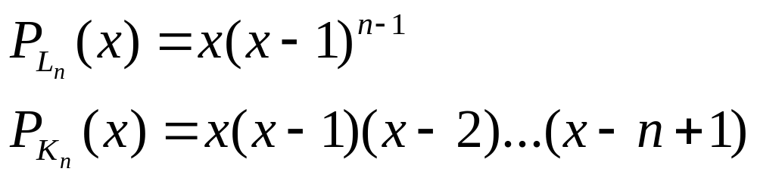
Chromatic Polynomials
P_{G}(x) is the number of different coloring for Graph G using x different colors (x≥n).

Slide 18
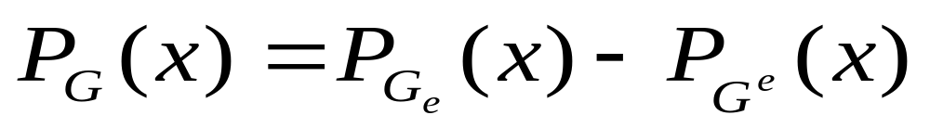
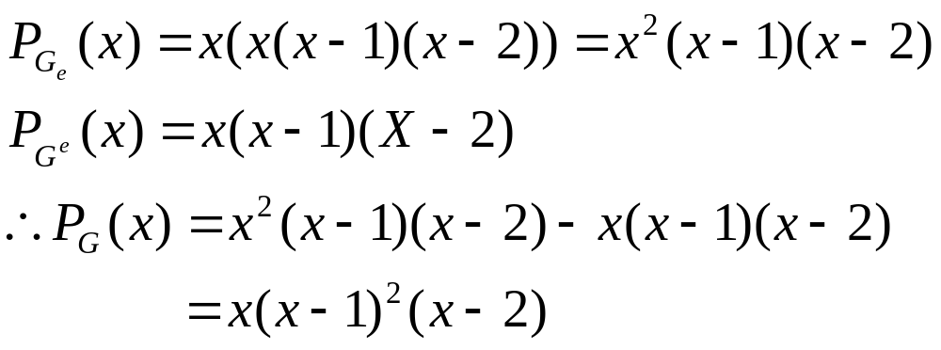
Subgraph and Quotient Graph
a
e
b

Slide 19
Concept of Planar Graph
Embedding of a graph in a plane
Planar graph
Note: planarity is a characteristics of a graph, not depending on the digram of the graph.
Note:
A graph without cycle is planar.
A graph is nonplanar if one of its subgraph is.
Planarity can be considered independently within a block of a disconnected graph.

Slide 20
Typical Non-planar Graph
Jordan定理：平面上一条封
闭曲线J 将平面分为“内部”和
“外部”两部分，分别位于内
部和外部的两个顶点之间的
连线必然与J 相交。
K_{3,3}
K₅
不管这第5个顶点加在何处，都出现Jordan条件

Slide 21
Regions of Planar Graph
每个平图将平面分割为一个无限(开放)区域与若干个(也可能是0个)封闭区域，分别称为外部面和内部面。
面的度数等于构成面边界的边数(注意：悬挂边算2度)
平图中面的度数之和等于图中边数的两倍。
1
1
2
5
7(无限区域)
10

Slide 22
平面图的一个必要条件
欧拉公式：若G是连通平面图，则对G的任一平图有n+r=m+2
其中：n=|V_{G}|, m=|E_{G}|, r是平图中的面数(包括无限区域)。
  证明：对m进行归纳。
  奠基
    当m=0, G是平凡图：n=1, r=1。
    当m=1, 必为下列两中情况之一：
      G=K₂, n=2, r=1。
      G是一个环，n=1, r=2。

Slide 23
平面图的一个必要条件（续）
欧拉公式：若G是连通平面图，则对G的任一平图有n+r=m+2
其中：n=|V_{G}|, m=|E_{G}|, r是平图中的面数(包括无限区域)。
  假设当m=k-1时结论成立。
  当m=k:
    I. 若G中含1次顶点v, 令G'=G-v, 显然：n'=n-1, m'=m-1, r'=r，因此：n+r=n'+r'+1=m'+2+1=m+2
    II. 若G中无1次顶点，G中必含回路，设e是回路上任一边，令G‘=G-e, 显然：n’=n, m‘=m-1, r’=r-1，因此：
    n+r=n'+r'+1=m'+2+1=m+2

Slide 24
简单连通平面图的必要条件
(实际上，当平图画不出时，欧拉公式很难直接使用)
欧拉公式的推论：若G是简单连通平面图(n≥3), 则m≤3n-6。
  证明：至少3个顶点的简单图G中，面的最小度数是3，∴3r≤2m, 根据欧拉公式：3r=3m+6-3n, ∴3m+6-3n≤2m, 即：m≤3n-6。
K₅不是平面图：在K₅中，n=5, m=10, 3n-6=9。

Slide 25
简单连通二步平面图的必要条件
欧拉公式的另一个推论：若G是简单连通平面图(n≥3), 且G是二步图，则m≤2n-4。
  证明：与上面类似，只需注意，简单连通二步图(n≥3)中，最小面次数是4。
K_{3,3}不是平面图：在K_{3,3}中，n=6, m=9, 2n-4=8。
(注意：K_{3,3}满足m≤3n-6)。

Slide 26
简单连通平面图的最小顶点次数
若G是简单连通平面图，则δ_{G}≤5。
证明：
  当n≤5, 显然。
  若n≥6, 注意：n·δ_{G} ≤ Σd(v) = 2m, 根据欧拉公式的推论：n·δ_{G} ≤ 6n-12, ∴δ_{G} ≤ 6-12/n, 因此：δ_{G} < 6

Slide 27
同胚图
u
u
w
基本动作：
  二次顶点的插入和消去
如果图G₁和G₂经过反复的插入和消去二次顶点，可达到同构，则G₁和G₂是同胚图。
v
v

Slide 28
图的收缩
u
基本动作：
图的收缩
u
w
(u,v)
e
v
v

Slide 29
平面图的充分必要条件
Kuratowsky定理
  图G是平面图当且仅当G中不含与K₅或者K_{3,3}同胚的子图。
  图G是平面图当且仅当G中不含可以收缩到K₅或者K_{3,3}的子图。

Slide 30
Kuratowsky定理的应用 (1)
Petersen图不是平面图
  它可以收缩到K₅

Slide 31
Kuratowsky定理的应用 (2)
左图的一个子图与K_{3,3}同胚。因此它是非平面图。
a
b
a
d
h
c
d
f
f
e
e
b
c
g
g
h

Slide 32

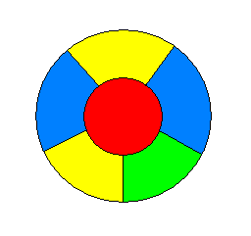
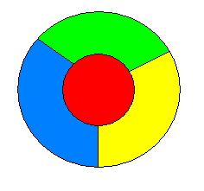
Francis Guthrie’s Conjecture
给地图的每个区域着色，保持任何有公共边界的区域使用不同颜色，只要四种颜色就够了。
可以证明：任何地图不会有这样的构型：5个区域，每个均与其它4个相邻。
误认为这蕴涵四色猜想导致许多错误证明
上图中没有4个区域两两都相邻，但三色不够。
很容易证明，三种颜色是不够的
- Guthrie, de Morgan

Slide 33
Martin Gardner’s Gift for Fool’s Day
A counterexample for four-color conjecture
？
Scientific American
Fool’s Day of 1975

Slide 34
Dual Graph of a Planar Graph
图G中的点和边
G的对偶图G’中的点和边
G’中每条边对应与G中的一条边，与G中割边对应的是环，可以将G’中每条边画成只与它对应的边相交，与任何其它G或G’中的边均不相交。

Slide 35
着色数不
大于4的图
黑
蒙
吉
甘
宁
辽
冀
新
陕
晋
京
津
青
鲁
渝
豫
川
苏
皖
沪
鄂
藏
浙
赣
黔
湘
滇
闽
桂
粤

Slide 36
四色地图猜想的另一种描述
每个平面图是4-可着色的当且仅当每个平面图是4-区域可着色的。
  只需考虑连通的情况
  如果G是任意平面图，考虑它的对偶图G’删除环以及多余的多重边后得到的简单图G*。G的任意两个区域相邻当且仅当G*中对应的两顶点相邻，因此只要G*可4-着色，G就可以4-区域着色。
  反之，G的对偶图的每个区域中只会包含G中唯一的顶点（为什么？）。于是，对偶图的任意两个区域相邻当且仅当他们所包含的两个G中顶点在G中相邻，因此只要那个对偶图是4-区域可着色的，G就是4-可着色的。

Slide 37
Five Color Theorem
Coloring a planar map, with different colors for adjacent areas, five colors is enough.
  Proof(sketch)
  There must be a 5-degree vertex in any simple planar.
  Induction on the number of vertices(if n≤5, obviously)
  induction as follows:
1
2
1
2
?
v
v
5
5
3
3
4
4

Slide 38
Home Assignment
pp.325-
  7, 8, 15-27

Slide 39
计算机数学时代的来临
1976年，伊利诺大学的Kenneth Appel和Wolfgang Haken,宣布他们证明了四色猜想。四色问题可能是仅次于费马大定理的最著名的未解决数学问题。然而对数学家们来说，整个事情最有戏剧性的部分是该论证的关键的部分是由计算机完成的，证明过程所需计算量如此巨大，对它进行逐步检验已非数学家人力所及，这就意味着整个“数学证明”的概念发生了突变，自从50年代初电子计算机发展以来一直在酝酿的事情终于发生:了计算机从数学家手中接过了从事真正的数学证明的重任。
然而在四色猜想的证明中，计算机起了实质性的作用-整个证明直接依赖计算机。为接受这个证明，你必须相信所用的程序确实做了其作者所说的事情。
多年后，人们还不时听到传闻，说在计算机程序中发现有重要错误，…但总得说来，拒绝接受四色定理计算机证明的数学家人数已在逐渐减少。
-- 摘自Keith Devlin: “数学：新的黄金时代”

